Slide 1
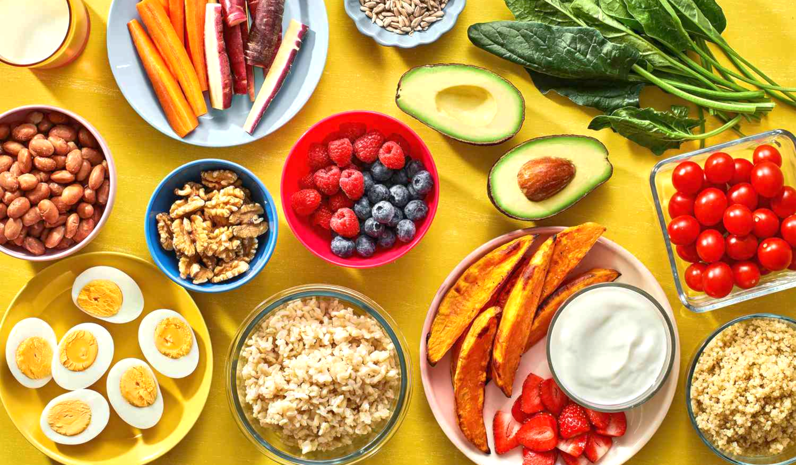
Different gut microbiota in U.S. formula-fed infants consuming meat vs. dairy-based complementary foods
BIOMI6300 Project 2
Yining Sun
2023.4.26

Slide 2

Infants 5-12 months of age
No longer rely solely on breastmilk or infant formula
Start to try solid foods progressively
Growth trajectories and shifts in gut microbiota ----> program long-term weight, body composition, and disease risks

Slide 3
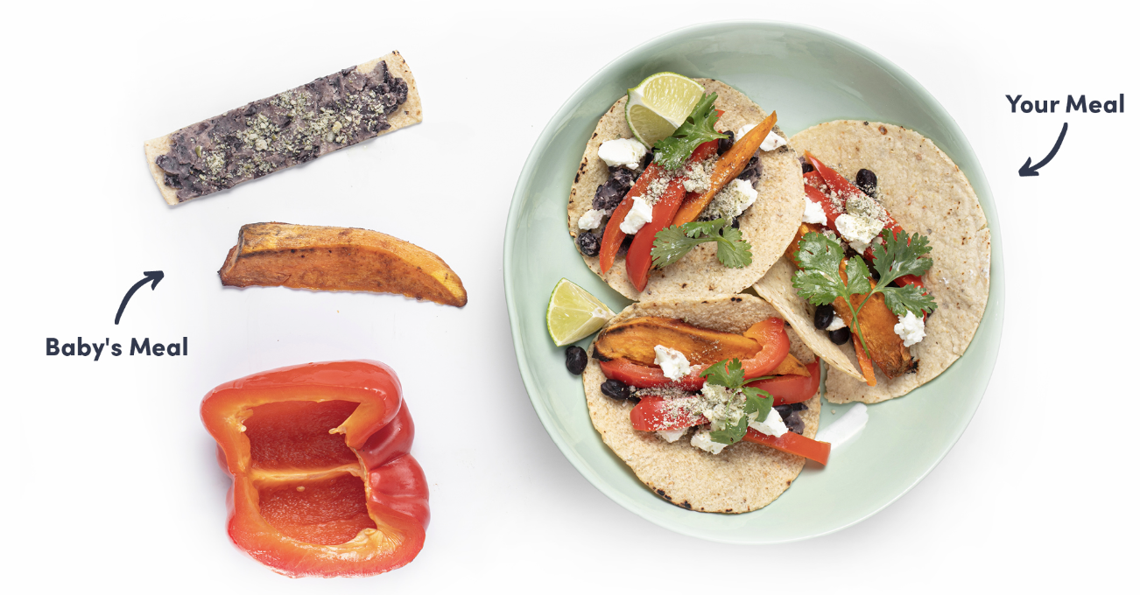
Research Gap
Although the gut microbiota is greatly influenced by diet, very few studies have addressed the effects of solid foods (complementary foods) on the development of the infant gut microbiota.

Slide 4
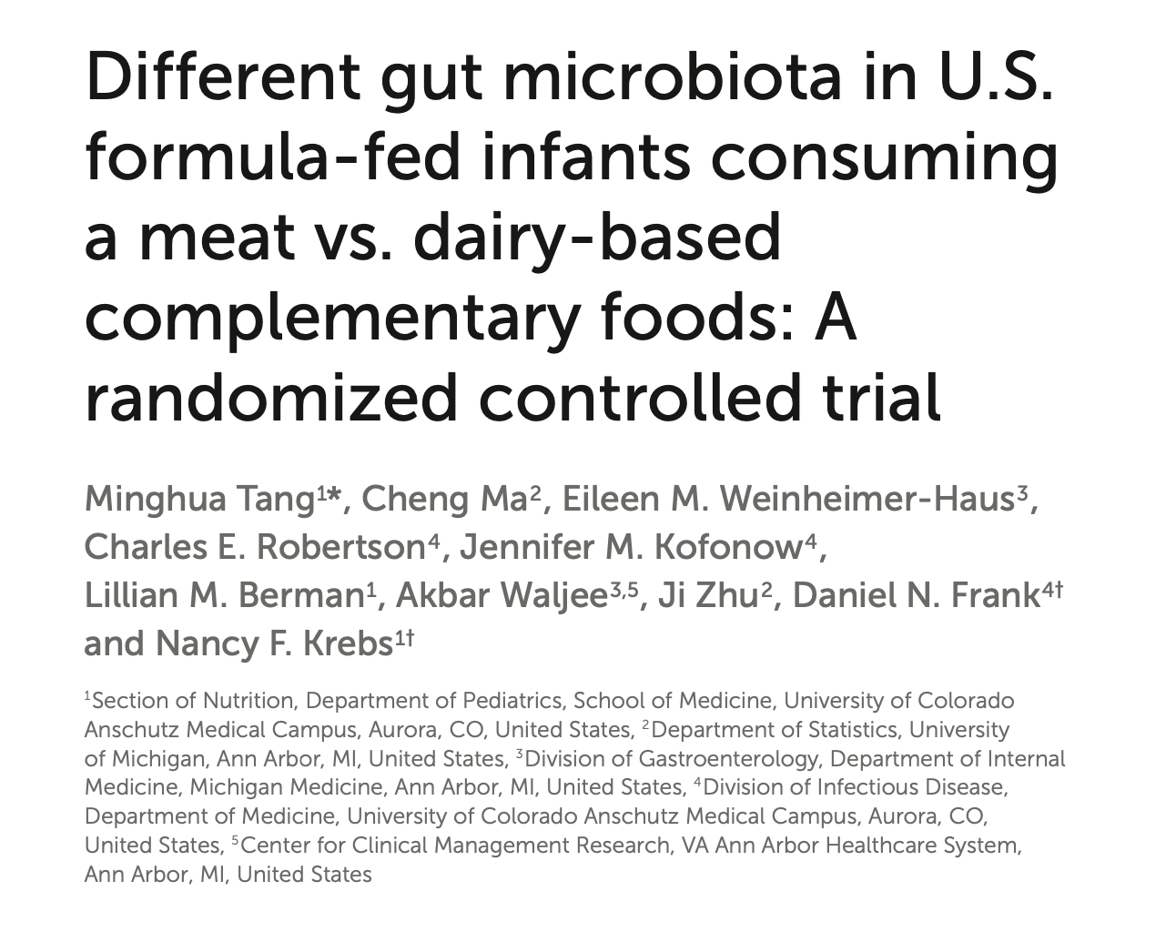
Objective:
This project aimed to evaluate the impact of meat- vs. dairy-based complementary foods on gut microbiota and whether it relates to growth.
(doi: 10.3389/fnut.2022.1063518)

Slide 5
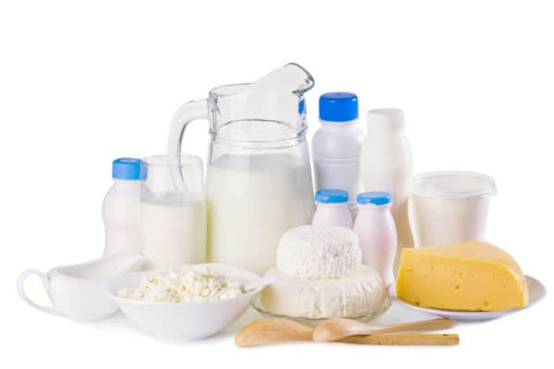
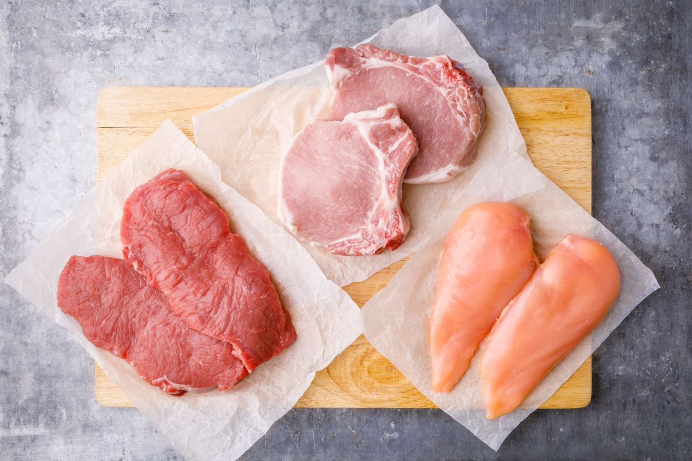
My hypothesis
The gut microbiota of formula-fed infants having meat as complementary food is different than that of those having dairy-based complementary food.

Slide 6
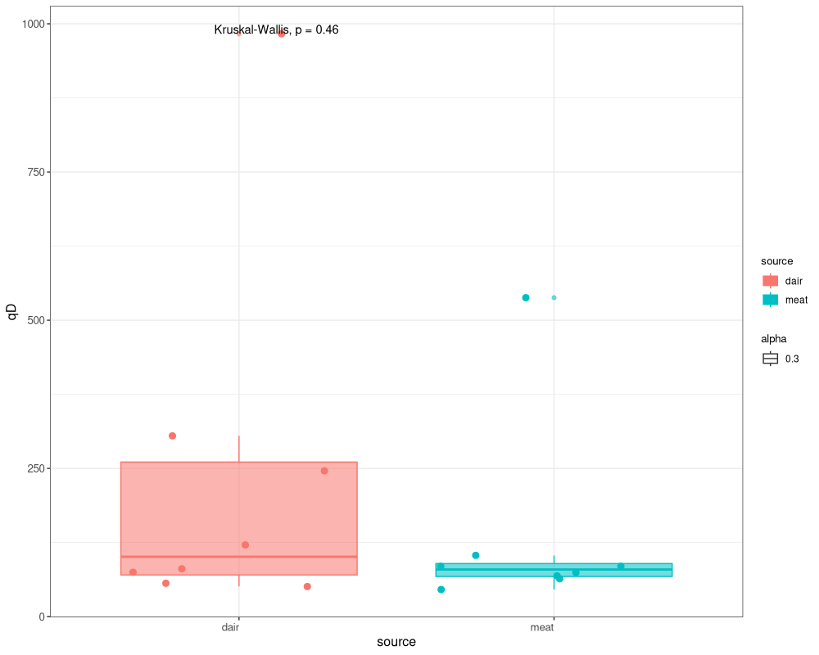
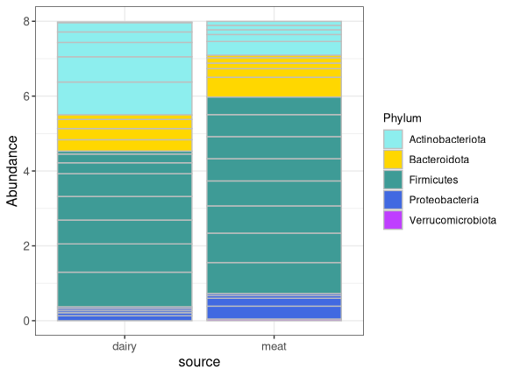
Results
Observed species richness
(Wilcoxon, p = 0.4945)
B. Compositional Analysis
(PERMANOVA, p > 0.5)

Slide 7
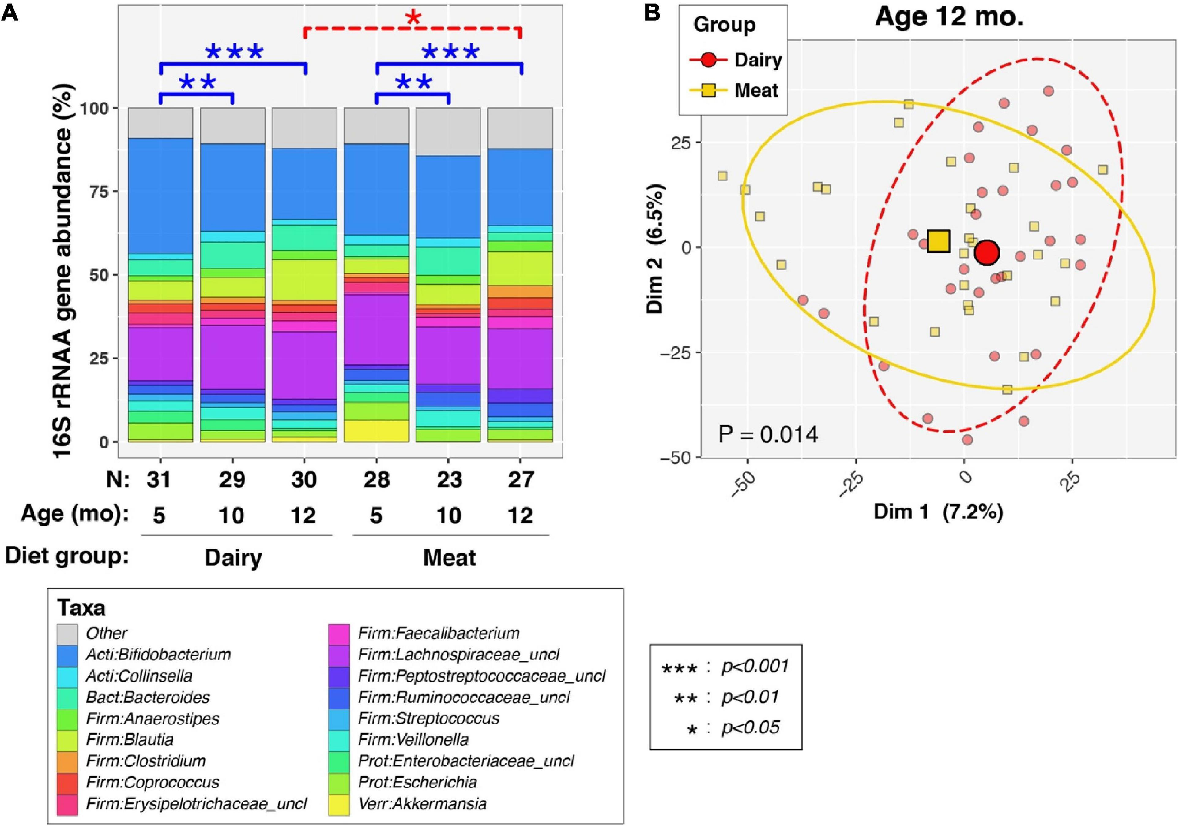
Tang et al. results

Slide 8
Thoughts
Not enough samples.
(Only picked 8 samples for each source group. In the study, N=64.)
No access to metadata, such as age, specific protein source, etc.
Different Illumina sequencing analysis pipelines were used.
My codes.

Slide 9
Thank you for your attention!

